Slide 1


Structure of proximal and distant regulatory elements
in the human genome
Ivan Ovcharenko
Computational Biology Branch
National Center for Biotechnology Information
National Institutes of Health
September 23, 2010

Slide 2


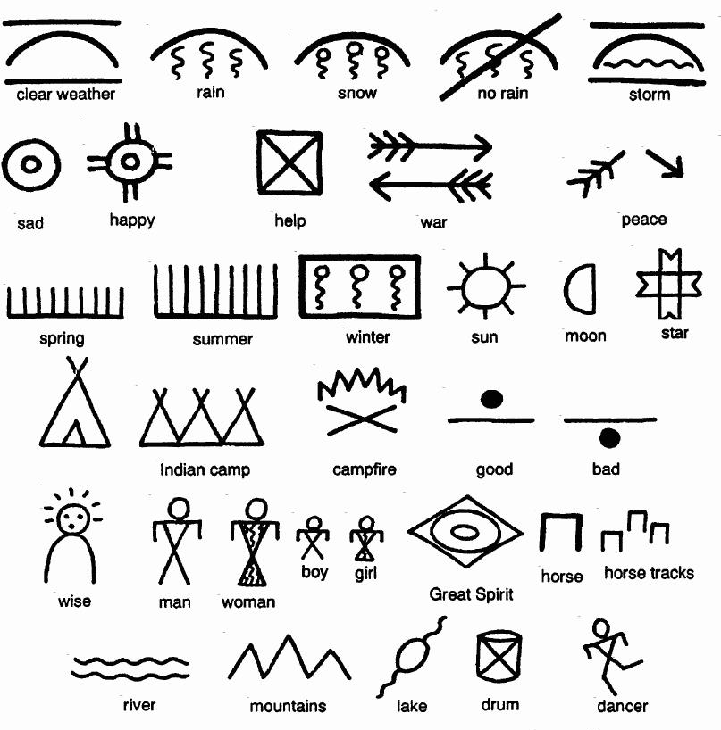
The Genome Sequence: The Ultimate Code of Life
3 billion letters
~ 45% is “junk” (repetitive elements)
~ 3% is coding for proteins
gene regulatory elements (REs) reside
SOMEWHERE in the rest ~50%

Slide 3
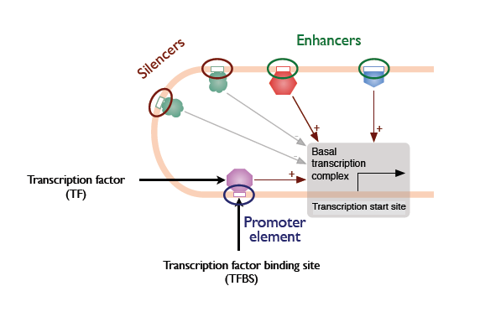
Distant Regulatory Elements

Slide 4
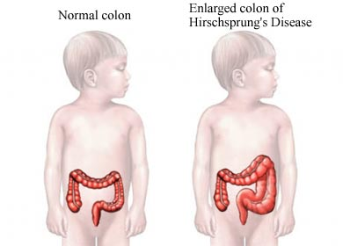
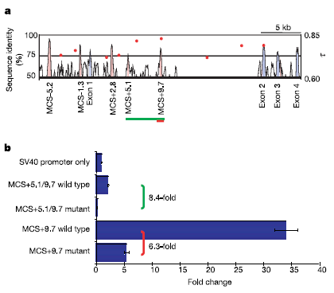
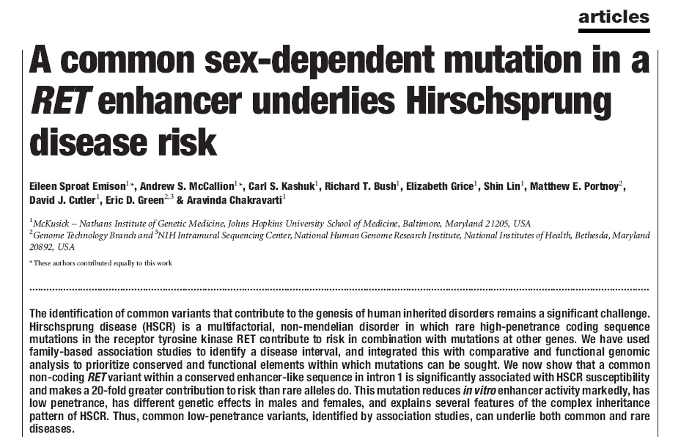
Hirschprung disease is associated with a noncoding SNP
RET
Notes:
There has always been interest in the genetics of different eye colors. A recent study showed that blue and brown are actually associated with a mutation within an intron of the HERC2 gene. The mutation does not affect the expression of HERC2 itself, but of the gene which is immediately downstream, the OCA2 gene, which is the one responsible for pigmentation. This is just an example of gene regulation and you can see the genotypes and corresponding phenotypes on this picture here. Regulatory elements (REs) orchestrate temporal and spatial expression of genes, and it is becoming more and more evident, that many diseases with a genetic basis can be actually linked to mutations in regulatory elements. This project intends to provide a higher insight into the rules of gene regulation.

Slide 5
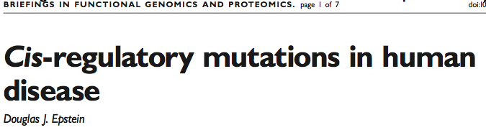
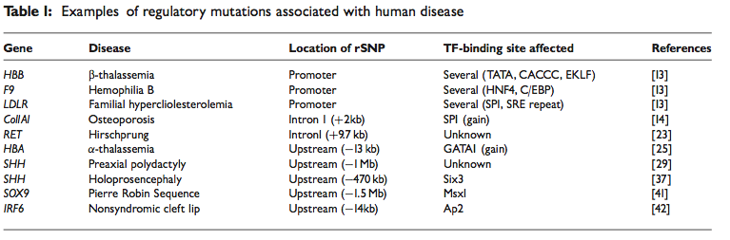
Hundreds of noncoding disease SNPs

Slide 6
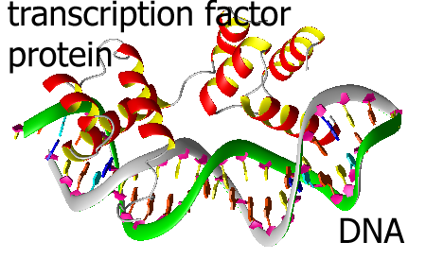

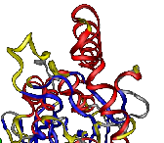
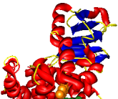
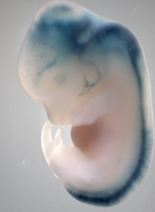
Combinations of binding sites define the biological function of regulatory elements
Transcription factors (TF) bind to very short binding sites (6-10 nucleotides) (TFBS)
Combinatorial binding of multiple TFs to a RE defines a specific pattern of gene expression
Correlating patterns of TFBS in REs with the biological function will “decode” the gene regulatory encryption
Protein A
Protein B
Protein C
GENE
DNA
TFBS
TFBS
TFBS
aCTGACTgaaaaCTGATATTGacagtTTGTTGTTGttaa
REGULATORY ELEMENT (RE)

Slide 7
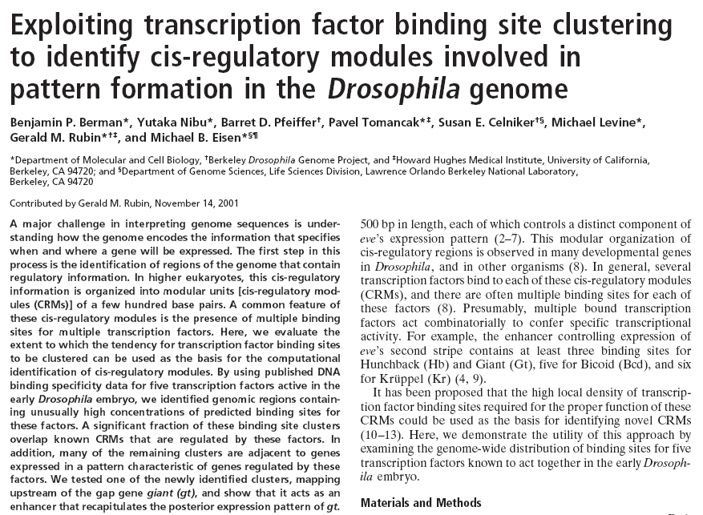
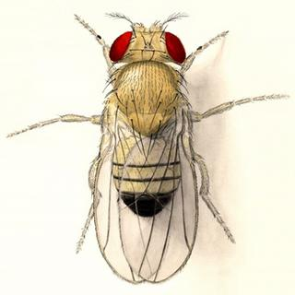

Slide 8
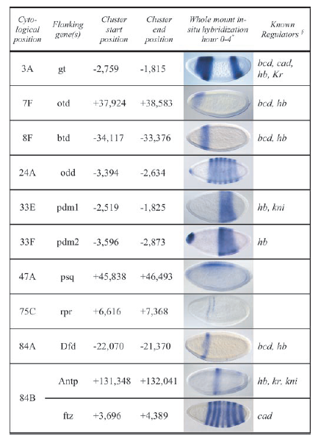
Homotypic TFBS clusters
  Are known to occur widely in nature (Arnone and Davidson, 1997)
  Provide redundancy for key regulatory events – cornerstone of developmental stability
  Respond to various concentrations of TFs (e.g. allow lowly abundant TFs to bind)
Berman et al. (2002) PNAS 99:757

Slide 9
Searching the human genome for
homotypic TFBS clusters
E2F_Q6_01 Cluster

Slide 10
Homotypic TFBS clusters in the human genome
~700 TRANSFAC & Jaspar PWMs were used to annotate putative TFBS in
the non-repetitive, non-exonic part of the human genome
A 2-state HMM model was trained to identify genomic regions with an
elevated density of TFBS events
TFBS “A”
TFBS cluster
< 500 bps
< 3kb

Slide 11
Only 33 PWMs have more than 1000 clusters
  126,000 homotypic TFBS clusters
  272 (40%) of TFs have at least 5 clusters
  Median length – 597 bps
  Median number of TFBS per cluster – 5
  Total genome span – 50.4 Mb (1.6%)
Direct
Indirect
Human specific

Slide 12
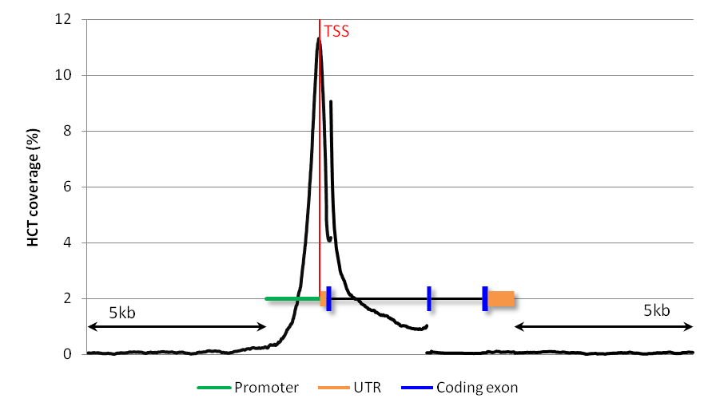
Homotypic TFBS are strongly associated with promoters
2290 clusters (47% of 4894 total) are in promoters
51% of human promoters contain at least 1 cluster

Slide 13
Fraction of clusters in promoters
p-val < 0.005 for 78 TFs

Slide 14
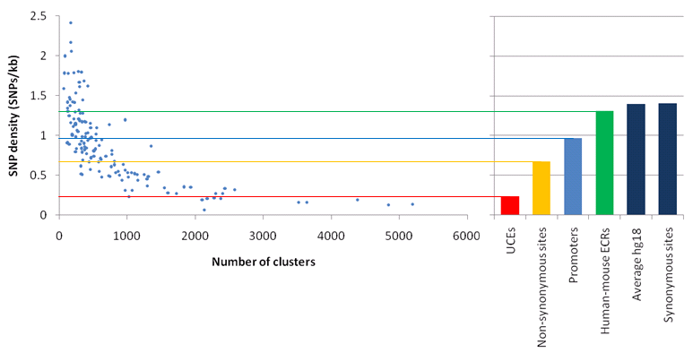
SNP density in clusters

Slide 15
Comparing TFBS to inter-site regions within clusters to avoid ascertainment bias
inter-site region
cluster

Slide 16
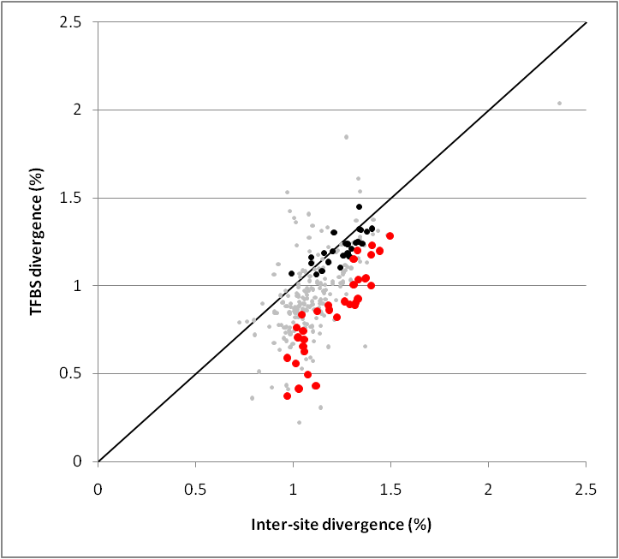
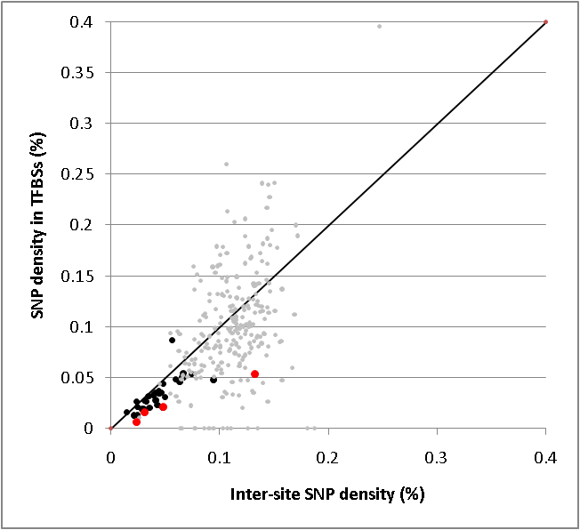
Two lines of evidence of negative selection acting on TFBS within TFBS clusters

Slide 17
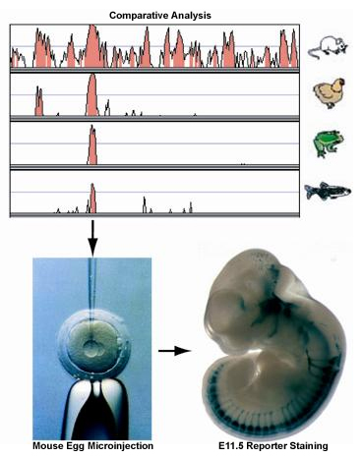
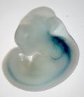
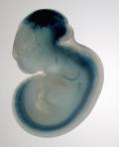
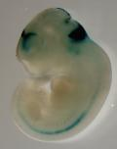
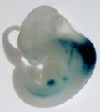
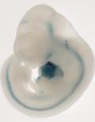
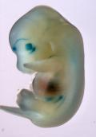
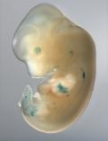
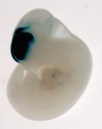
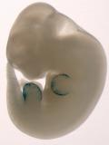
Overlap with in vivo developmental enhancers
http://enhancer.lbl.gov
“deep” or “ultra”
conservation
346 ENHANCERS
503 NEGATIVES

Slide 18
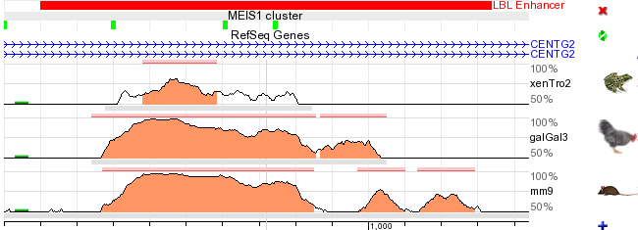
LBL enhancers overlapping conserved homotypic clusters
p-value < 10⁻¹⁰⁰

Slide 19
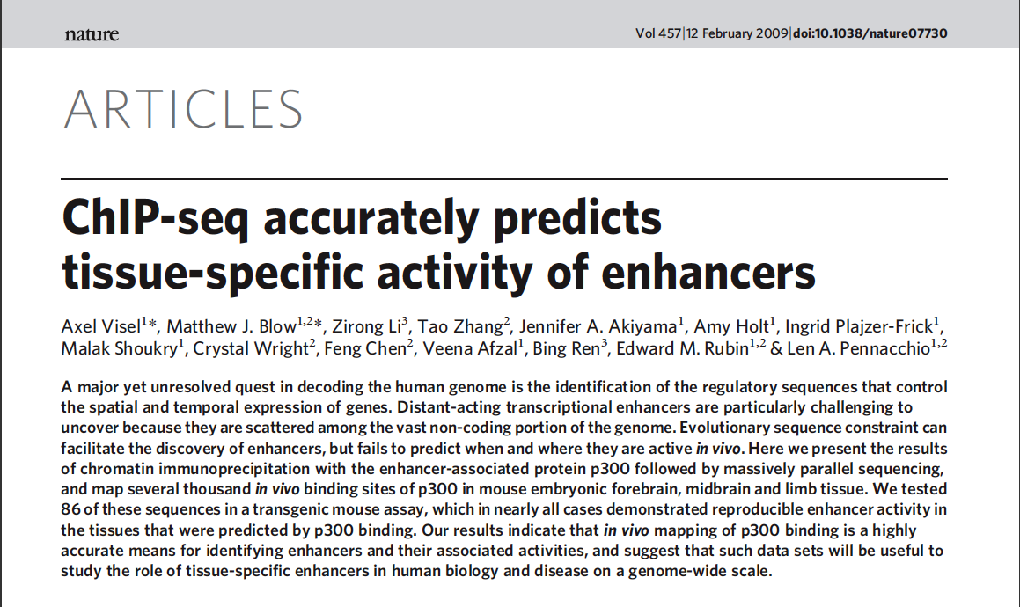
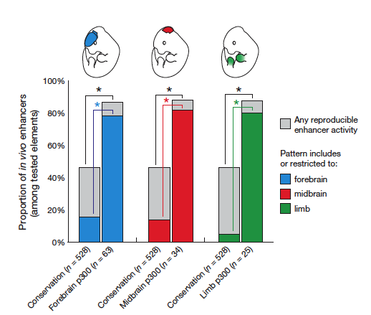
Breaking the code. TF – tissue associations.

Slide 20
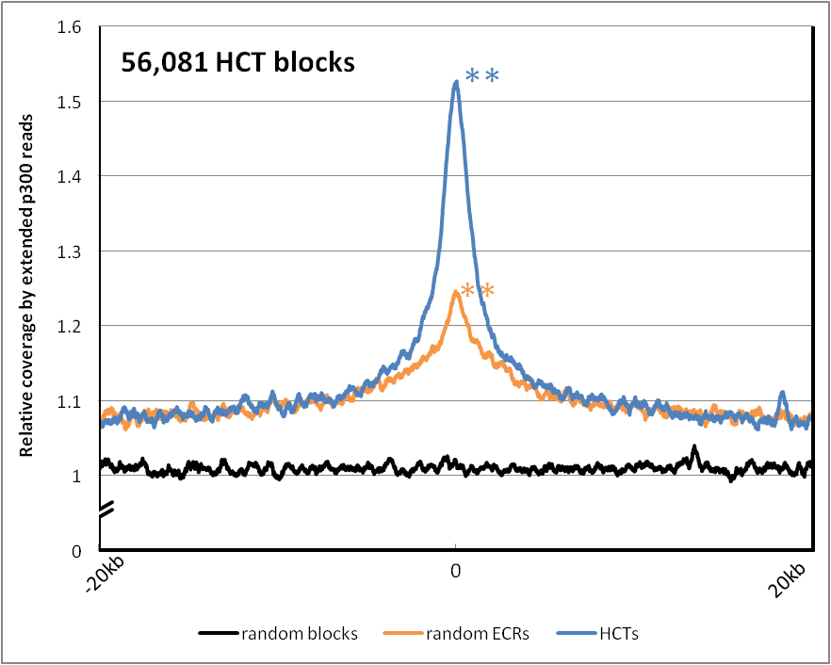
3-fold stronger association with p300 binding than expected
enhancer

Slide 21
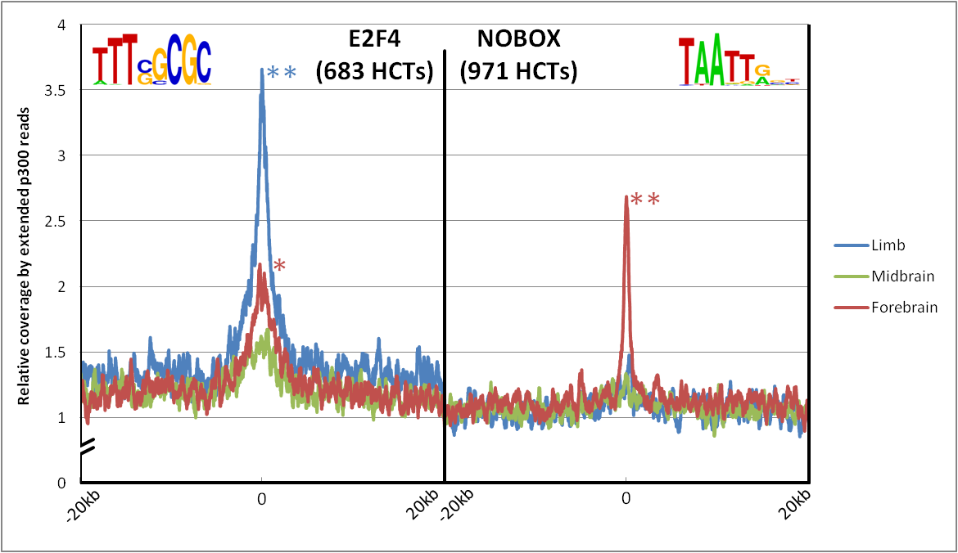
Tissue-specific association of NOBOX and E2F4
E2F4 HCT
NOBOX HCT
25-fold difference, P=2.99·10⁻⁵⁰

Slide 22
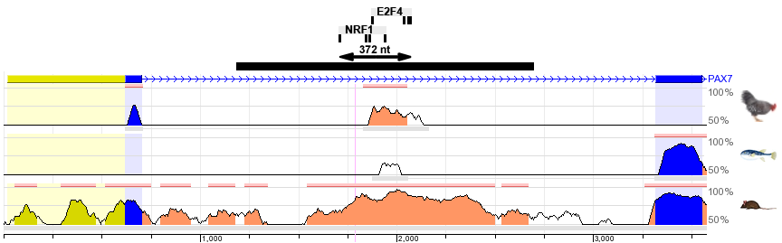
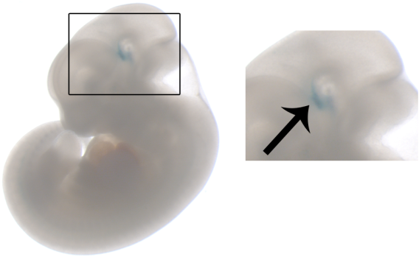
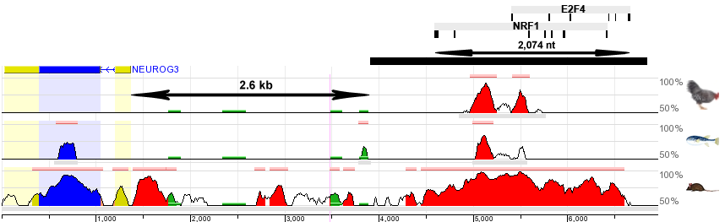
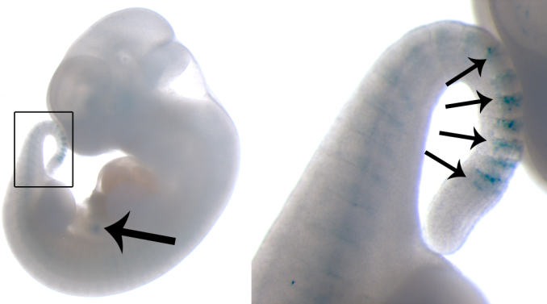
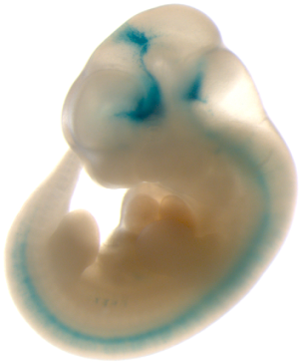
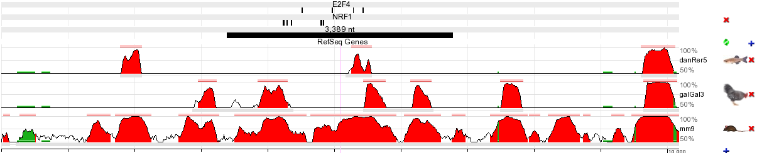
Experimental validation, E2F4 & NRF1 clusters
A
diencephalon
B
caudal
somites
pancreas
subregions of
forebrain, midbrain,
hindbrain
C
Lawrence Berkeley Lab
Axel Visel
Len Pennacchio
neural tube

Slide 23
Summary
Homotypic TFBS clusters are abundant in the human genome;
they span 50.4 Mb (1.6% of the genome) – about as much as coding DNA
~50% of human promoters contain a homotypic cluster of binding sites
~50% of validated enhancers contain a homotypic cluster of binding sites

Slide 24

Acknowledgements
Valer Gotea
Lawrence Berkeley Lab
Axel Visel
Len Pennacchio

Slide 25
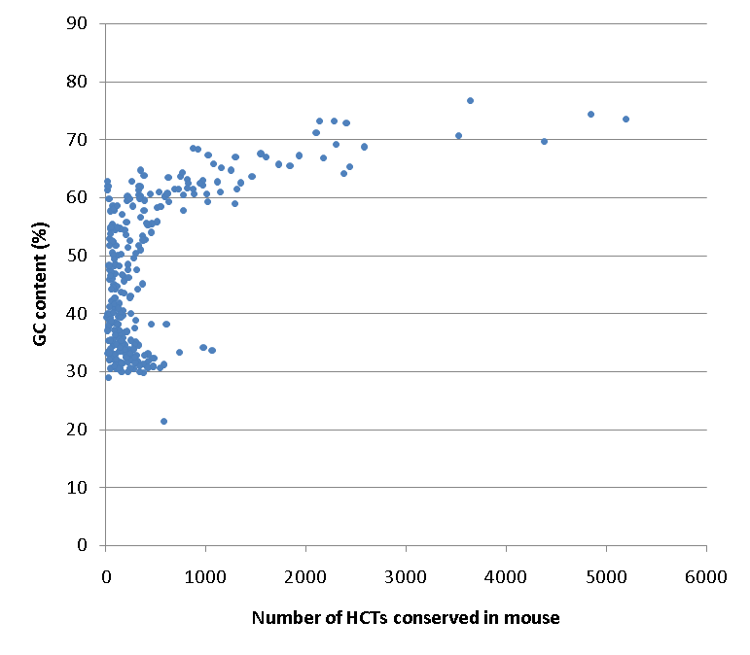
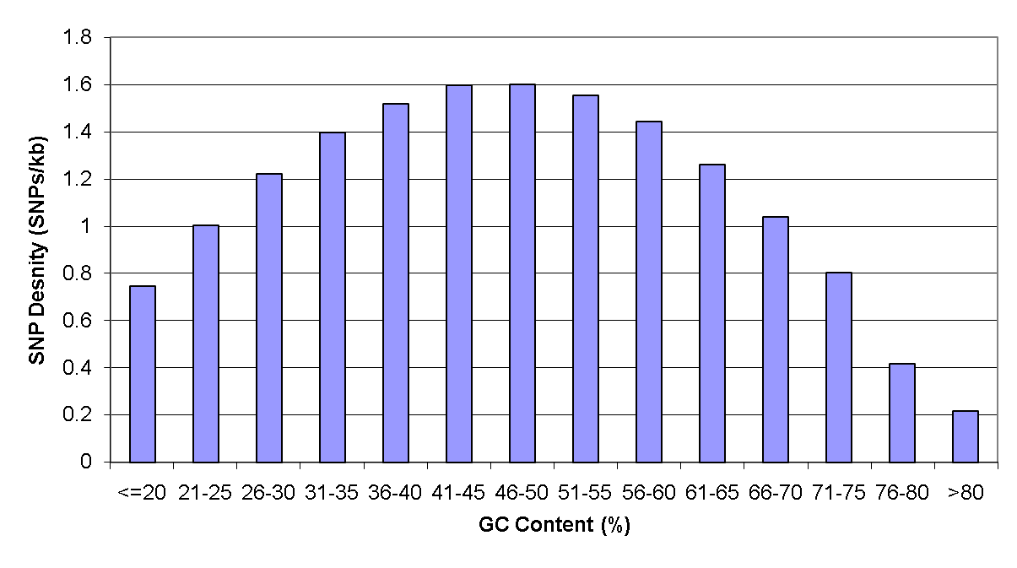
SNP ascertainment bias leads to low SNP density in clusters

