Slide 1


Bridging the genotype and phenotype
Teresa Przytycka
NIH / NLM / NCBI
RECOMB 2010

Slide 2
GWAS studies – Genome wide scan for genotype - phenotype association

Slide 3
Expression as quantitative trait

Slide 4
expression Quantitative Trait Loci analysis (eQTL)
Control 1
Control 2
Control 3
Case 1
Case 2
Case 3
Case 4
Case 5
Case 6
Case 7
Case 8
Putative causal gene/loci
Putative target gene
Phenotype
…
Gene 1
Gene 2
Gene 3
.
.
.
.
.
Gene 3
SNP 1
eQTL
SNP 2
SNP 4
Individuals
Individuals

Slide 5
Importance of expression as quantitative trait
Provides huge array of phenotypes
Identifies putative regulatory regions
It can be combined with “higher level” phenotypic variations such as diseases

Slide 6
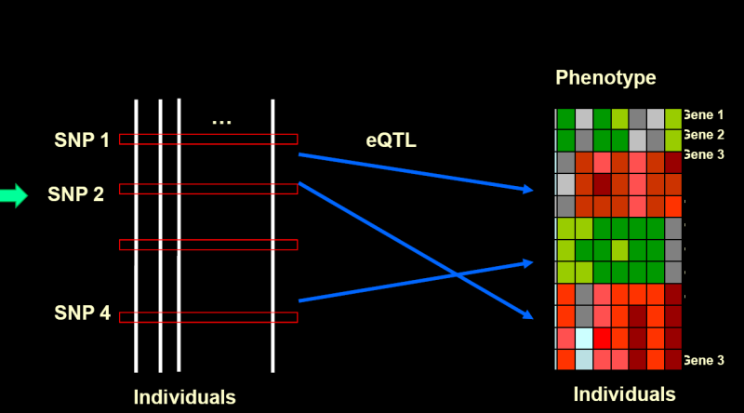
Challenges
Limited statistical power due to multiple testing
The expression of a gene might be influenced by many loci in additive or non-additive way
While we assume that the genetic variation is the cause and expression change is the effect, we don’t know molecular mechanism behind this relation
For genotype variation defined by changes of gene copy number, what is the impact of copy number variation on the expression of a given gene?

Slide 7
Challenges
Limited statistical power due to multiple testing
  Yang et al. ISMB 2009; Bioinformatics 2009
The expression of a gene might be influenced by many loci in additive or non-additive way
            Yang et al. in preparation
While we assume that the genetic variation is the cause and expression change is the effect, we don’t know molecular mechanism behind this relation
            Kim et al. RECOMB 2010
What is the impact of copy number variation on the expression of a given gene?
            Malone, Cho et al. in preparation

Slide 8
Challenges
Limited statistical power due to multiple testing
  Yang et al. ISMB 2009; Bioinformatics 2009
The expression of a gene might be influenced by many loci in additive or non-additive way
            Yang et al. in preparation
While we assume that the genetic variation is the cause and expression change is the effect, we don’t know molecular mechanism behind this relation
            Kim et al. RECOMB 2010
For genotype variation defined by changes of gene copy number, what is the impact of copy number variation on the expression of a given gene?
            Malone, Cho et al. in preparation

Slide 9
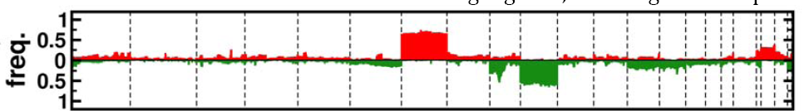
Copy number variations in cancer

Slide 10
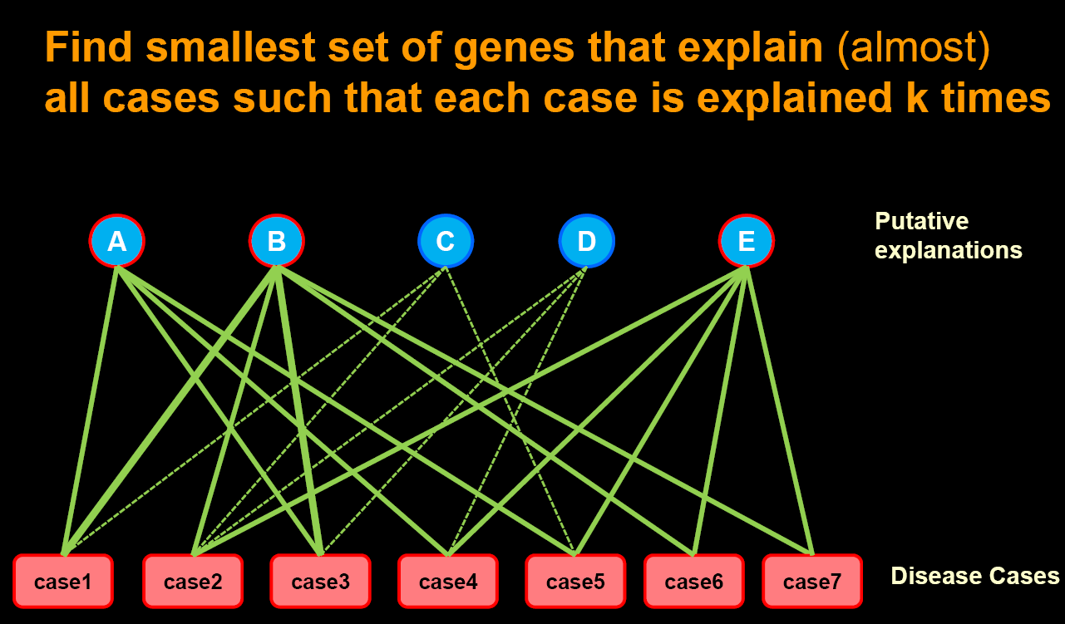
controls
Disease Cases
Disease Associated over/under expressed genes?
Gene 1
Gene 2
Gene 3
.
.
.
.
.
Gene 3

Slide 11
controls
Disease Cases
…
Gene 1
Gene 2
Gene 3
.
.
.
.
.
Gene 3
loci
Gene 1
Gene 2
Gene 3
.
.
.
.
.
Gene 3
eQTL
…

Slide 12
Genotypic variations
Candidate
genes
Gene Network
Target Gene
Case 1
Case 2
…
Case 7
C1
C2
…
C3
D
C4
C5
-
+
Current flow

Slide 13
Adding resistance
Genotypic variations
Candidate
genes
Gene Network
Target Gene
Case 1
Case 2
…
Case 7
C1
C2
…
C3
D
C4
C5
-
+
Current flow
R is set to be reversely proportional to the average correlation of the expression of the two genes with copy number variation of C2

Slide 14
controls
Disease Cases
Select subset that “explains” the disease
4
1
3
Gene 1
Gene 2
Gene 3
.
.
.
.
.
Gene 3
2
…
D
14

Slide 15
Putative Causal gene
Causal gene
has copy number variation in the given case,
low p-value pathway connecting it to a target gene that is differentially express in the same case
Case
# of such causal target genes = edge weight

Slide 16
Tree important sets of genes of interest
Disease genes
Causal geneses
Disease hubs – genes that appear on many disease related pathways (pathways from a causal gene to a diseases gene)

Slide 17
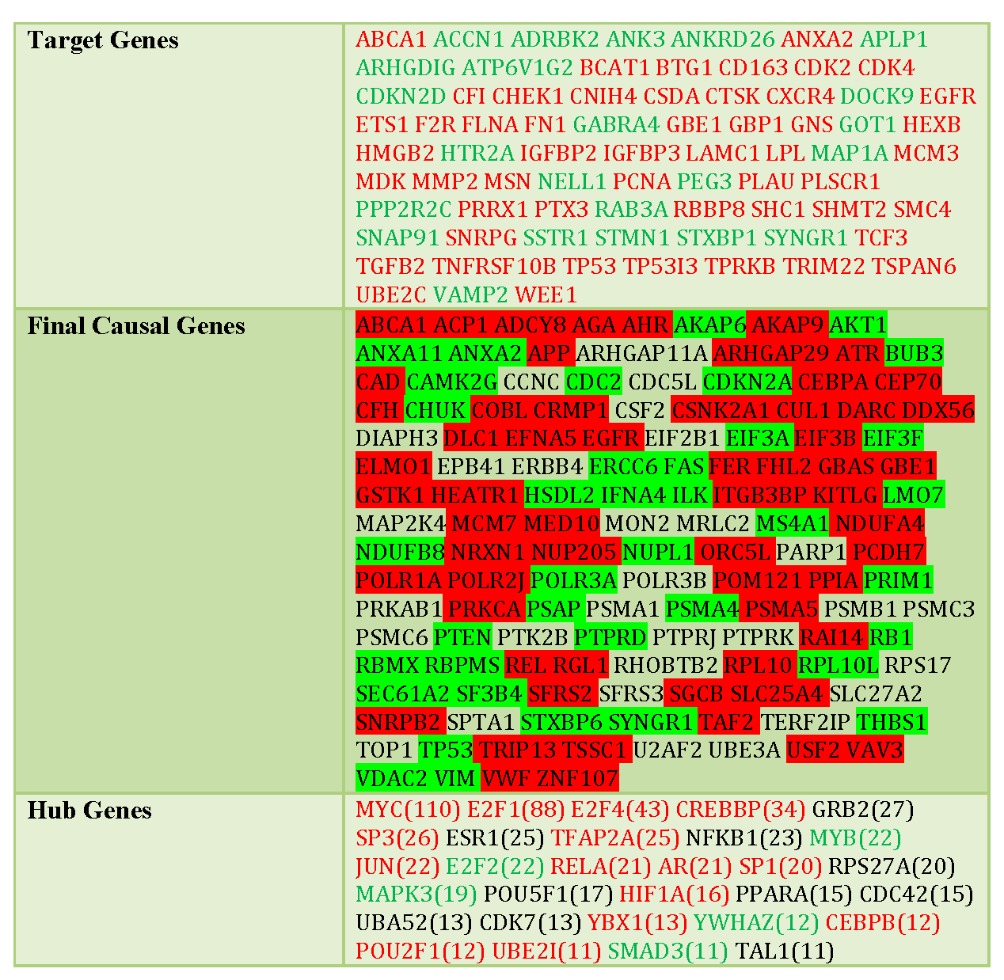

Slide 18
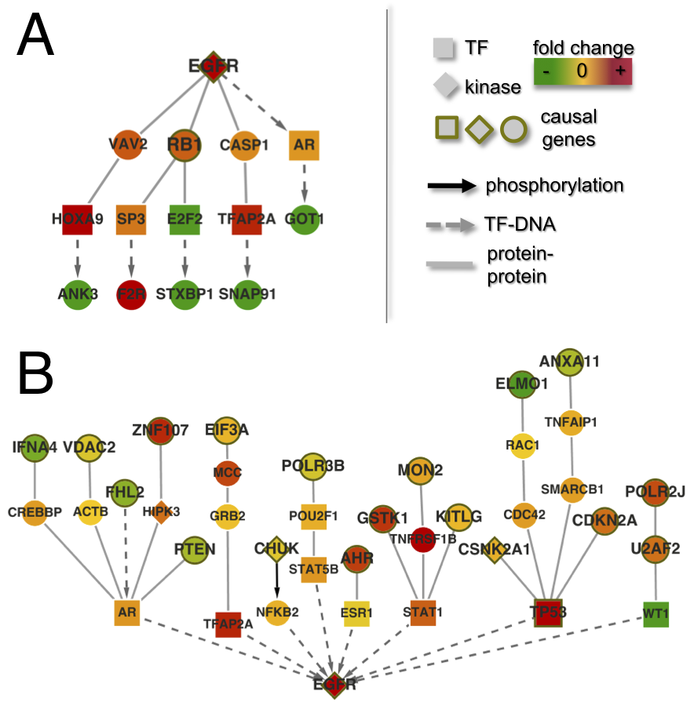

Slide 19
Caveats:
Some edges (e.g. transcription regulation) have direction
At the end of each path there must be a transcription factor which directly affects gene expression
Design appropriate permutation test to support the results
The current flow needs to be solved on a huge network

Slide 20
Caveats:
Some edges (e.g. transcription regulation) have direction
At the end of each path there must be a transcription factor which directly affects gene expression
Design appropriate permutation test to support the results
The current flow needs to be solved on a huge network

Slide 21
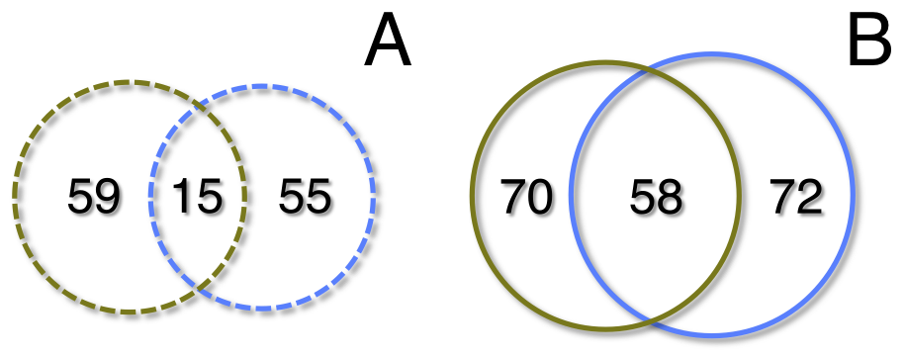
Dropping the restriction that last last but one node on the pathway is a TF
target genes overlap causal genes overlap

Slide 22
Network distances nodes
In the two sets

Slide 23
Effect of copy number variation of a gene on expression of this gene:
Expected:
But sometimes we observe :
Copy #
Expression
Example CDK2, negative correlation -0.28
Copy #
Expression

Slide 24
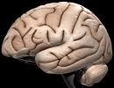
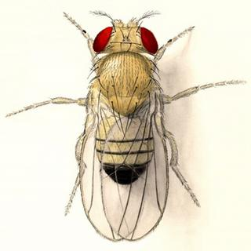
Impact of gene copy number variation (CNV) on gene expression;
DrosDel
(collaboration with experimental group of Brian Oliver NIDDK)
GLIOMA
(this work)
Copy number variations caused by:
Experimental knock-out of one copy
of a region (drosDel lines)
Somatic cell mutation
How changes in copy number propagate trough the cellular system :
Phenotype → Genotype
Identify “causal” CNV and dys-regulated pathways
Genotype → Phenotype
How the organism reacts to the change in gene dosage

Slide 25
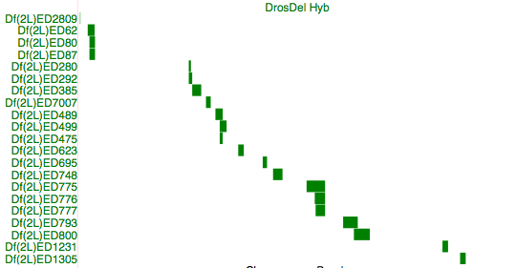
DrosDel lines profiled
8 MB and ~ 700 genes deficient
chr2L

Slide 26
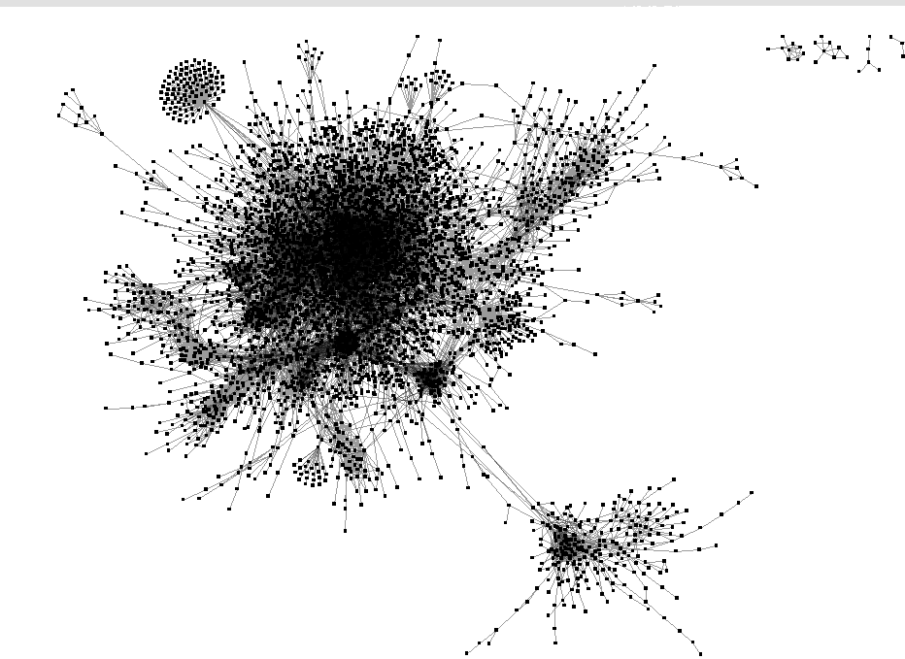
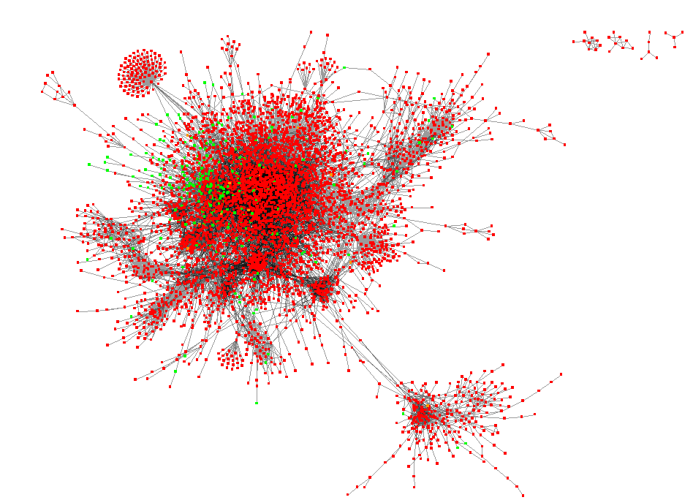
How fly responses to gene deletion
+/+
Df/+
Dose
?
Genotype
?
Network Cascade
Phenotype
?

Slide 27
How fly responses to gene deletion
+/+
Df/+
Dose
?
Genotype
?
Network Cascade
Phenotype
?

Slide 28
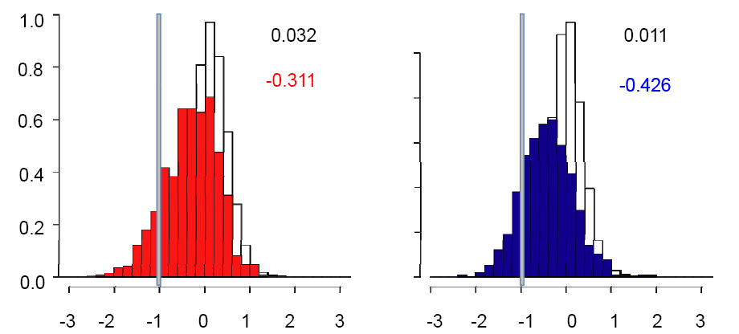
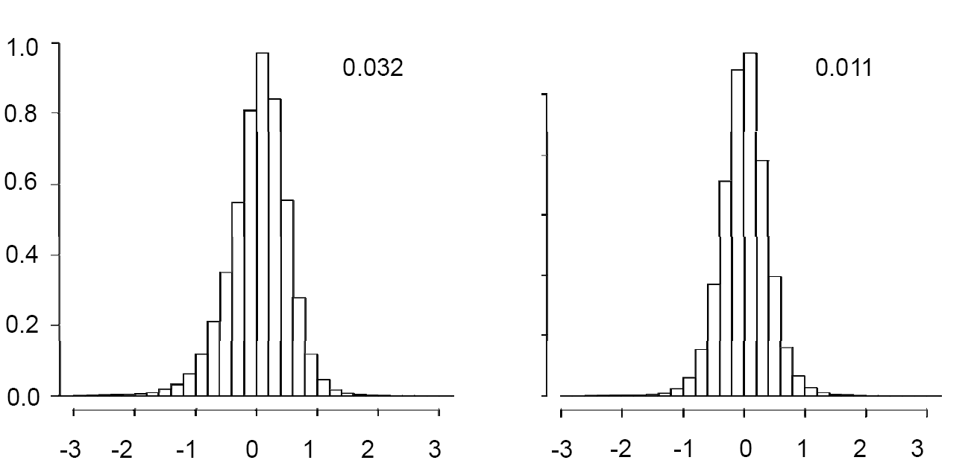
Distribution of Expression Fold Changes
Females
Males
-3
-2
-1
0
1
2
3
-3
-2
-1
0
1
2
3
log 2 Mean Df/+ / +/+ Expression
log 2 Mean Df/+ / +/+ Expression

Slide 29
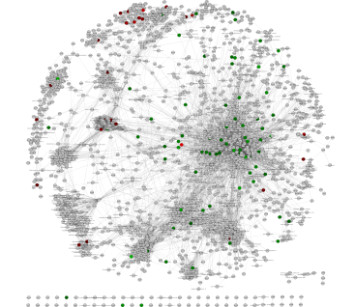
Network Buffering?
Genotype
Dose
FEEDBACK
Females
Df/+
To network
Adjusted dose
Less feedback
Males
Df/+
To network
Reduced adjusted dose

Slide 30
Acknowledgments
Przytycka’s group
Dong Yeon Cho
Brian’s Oliver group (NIDDK / NIH)
John Malone;
Justen Andrews Indiana University
Przytycka’s group
Yoo-ah Kim
Collaboration
Stefan Wuchty NCBI
Thanks to other members of Przytycka’s group
Yang Huang, Damian Wojtowicz, Jie Zhang, Dong Yeon Cho
Funding NIH intramural program

Slide 31

height
AA
Aa
aa
Height - Quantitative trait

Slide 32
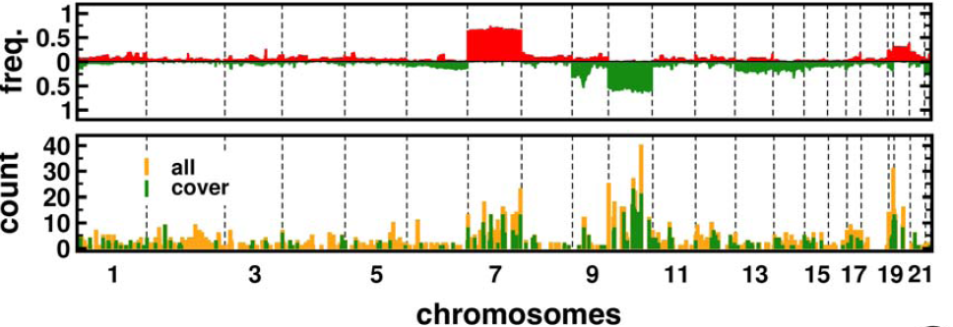
Starting from selecting “disease genes” we identified copy number variations that associate with expression changes of these genes and putative pathways that propagate the genetic perturbation from copy number variation to the disease genes

Slide 33
I computed p-values in the different levels of our algorithm and the following table shows the results.
* GBM genes listed in AceView. 93 genes are listed.
** results with the best p-value among experiments with different parameters
Gene 1
Gene 2
Gene 3
.
.
.
.
.
Gene 3
…
D
BSOSC Review, November 2008
33
33
 | Number of Genes | AceView | DAVID
Association | 16056 | 0.56 (75) | 0.027 (56)
Circuit flow algorithm | 701 | 0.045 (10) | 1.3 × 10⁻¹⁰ (25)
Circuit flow + set cover | 128 | 4.7 × 10⁻⁴ (6) | 9.9 × 10⁻⁵ (8)

