Slide 1
Factors affecting mRNA expression in a large population study
Peter J. Munson, Ph.D.
Mathematical and Statistical Computing Laboratory
Division of Computational Bioscience
Center for Information Technology, NIH

Slide 2
Systems Biology
Has been greatly facilitated by completion of human genome
Can only proceed if high-quality, broad, deep datasets are available
Growing number of such datasets in model systems (yeast, mouse, zebrafish) are available
Limited number of such datasets exist in human:
  GWAS studies (not clear if useful to systems biology)
  NCI-60, Affymetrix tissue data, Novartis GeneAtlas, e.g.

Slide 3
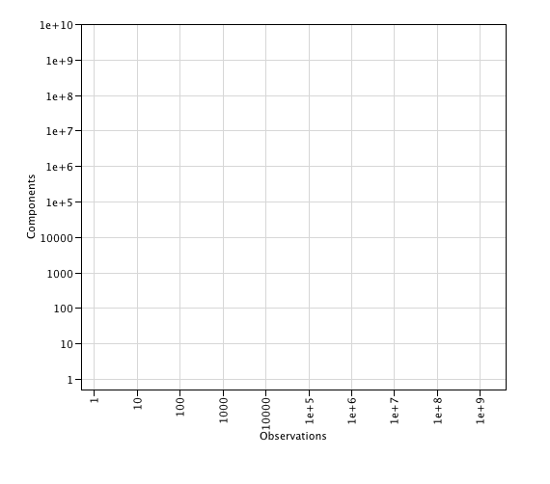
Space of “systems-friendly” datasets
Traditional laboratory research has great depth (many details)
Population studies have great breadth
Genomically-informed Systems Biology requires both depth and breadth (many observations on many components)
Depth
Breadth

Slide 4

Space of “systems-friendly” datasets
Depth
Breadth

Slide 5

Space of “systems-friendly” datasets
Depth
Breadth

Slide 6

Space of “systems-friendly” datasets
3 billion base pairs
One SNP every 300 bp
Depth
Breadth

Slide 7

Space of “systems-friendly” datasets
6 million parts, 1500 aircraft
Depth
Moderately-sized molecular simulation,
1000 atoms, 100 million steps
Breadth

Slide 8

Space of “systems-friendly” datasets
Depth
GWAS studies
listed at NCBI dbGAP
Breadth

Slide 9

Space of “systems-friendly” datasets
Functional Genomics:
We wish to measure not just identity, but quantity of ~30,000 transcripts comprised of 300,000 exons
This is now measurable in single Affymetrix HuEx1.0_st array
We want this on a very large number of samples
Depth
Breadth

Slide 10
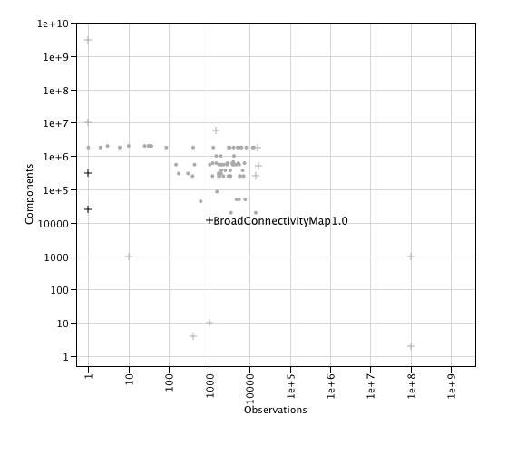
Space of “systems-friendly” datasets
Broad Connectivity Map measured how expression of 12,000 genes is affected by ~1,000 compounds, hormones, drugs, biologics using standard cell lines.
Depth
Breadth

Slide 11

Space of “systems-friendly” datasets
Framingham SABRe project 3 case-control study assesses RNA expression in 222 cases of MI, CABG, PRCD, ABI with 222 age, sex matched controls.
Depth
Breadth

Slide 12
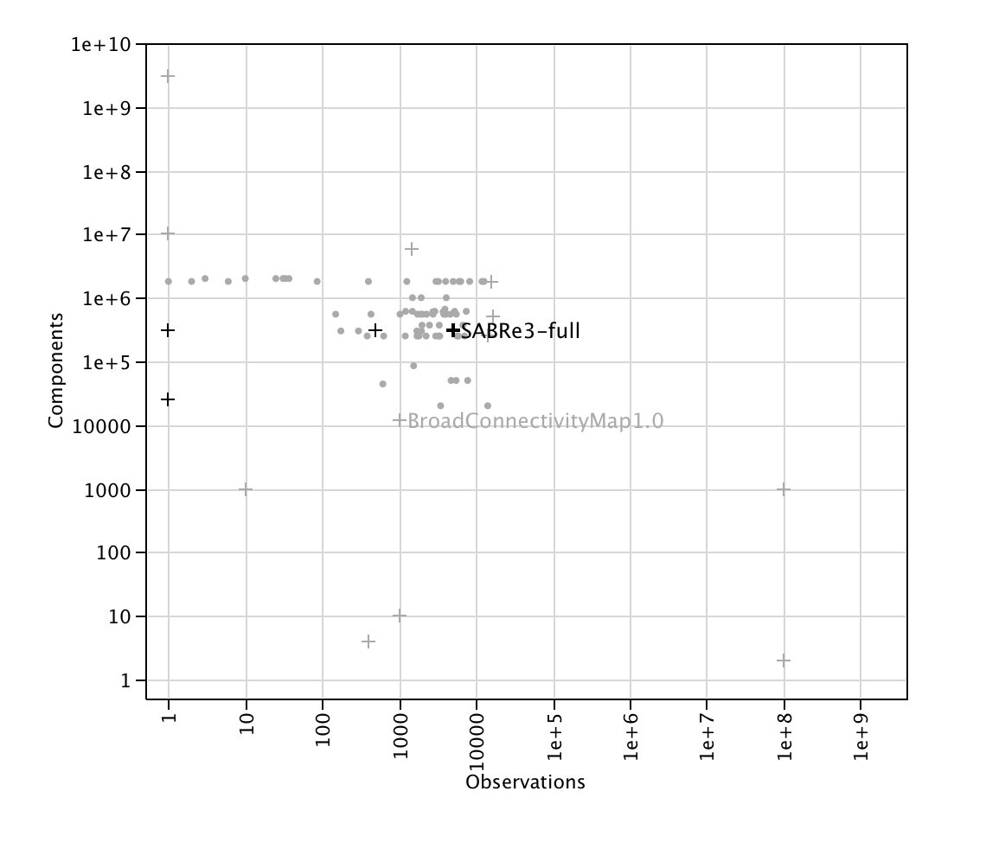
Space of “systems-friendly” datasets
When completed SABRe Project 3 will assay 5,000+ samples from Framingham population, for expression of 300,000 exons, 20,000 genes, accompanied by detailed health histories
Depth
Breadth

Slide 13
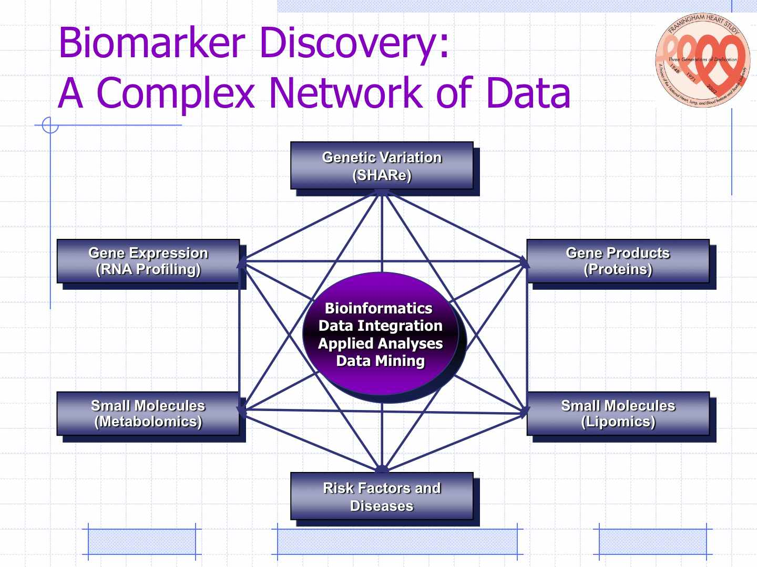

Slide 14
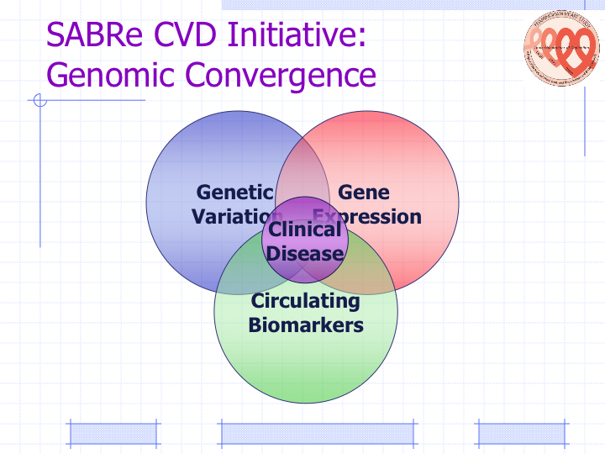

Slide 15
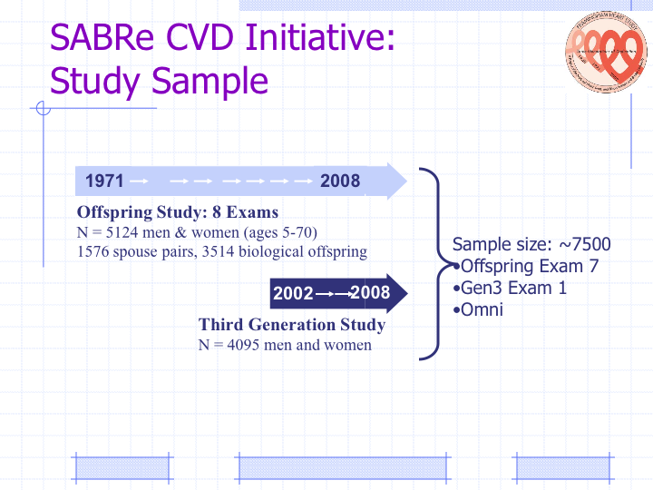

Slide 16
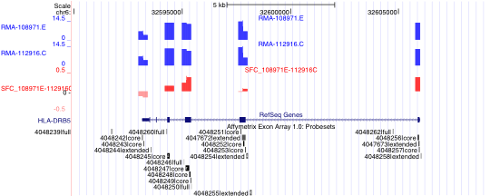
Affymetrix HuEx_1.0_st Array
6.5 million probes,
1.4 million probesets targeting
1.2 million exons, every known or predicted exon in the genome
Allows for genome-wide screening of expression and alternative splicing events

Slide 17
SABRe CVD Project 3
Phase 1: Feasibility study. Choose appropriate sample type (whole blood, PBMC fraction, lymphoblastoid cell lines), based on 50 samples of each type – completed 10/2009
Phase 2: Case-control study of MI, CABG, PRCD, ABI with age, sex matched controls – completed 7/2010
Phase 3:
~2,000 Offspring generation samples –12/2010
~3,000 Gen3 Exam 1 samples – 7/2010

Slide 18
Analytical Challenges
Quality control
Quality control
Quality control
Detect significant biomarkers
Account for un-matched covariates
Account for Batch effects

Slide 19
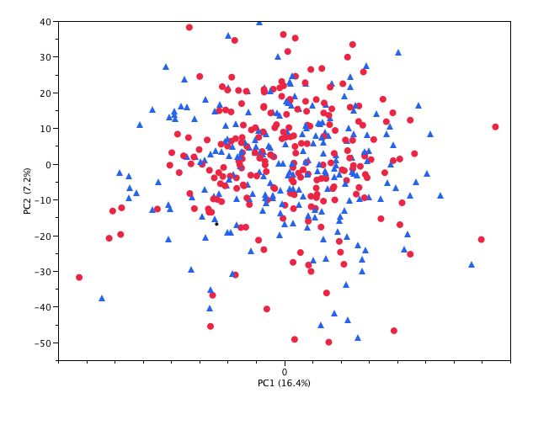

Principal Components Analysis
No separation of case control in PC1, PC2
control
case

Slide 20
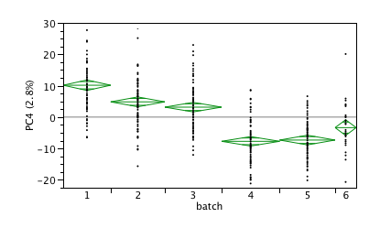
Principal Components Analysis
Samples handled robotically in batches of 96
Cases/controls balanced within batch
One batch per week
Substantial batch effect (as expected)

Slide 21
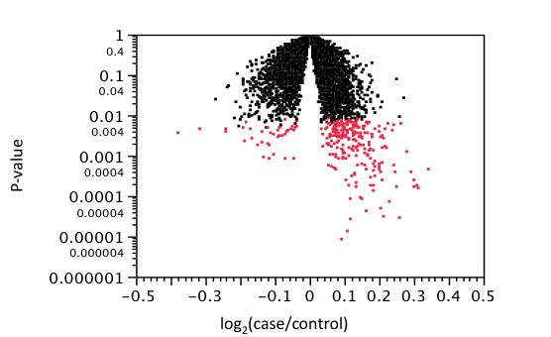
Preliminary Result
279 genes are significant at FDR<50%, Paired t-test

Slide 22
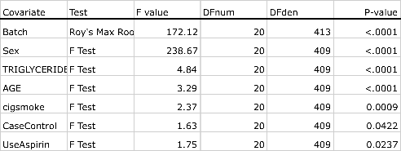
Other Factors Affecting Expression
MANOVA of gene expression on covariates using 20 PCs (45% of total variability)
Sex (primarily due to presence of chrY)
Batch (need better ways to mitigate this effect!)
Identify genes affected by Smoking, Triglyceride level, Age and maybe Aspirin Use
Can now identify biomarker genes (later exons) for Case-ness

Slide 23
Further Steps
Account (adjust) for covariates
Mixed-effect model analysis to better account for batch
Network analysis (systems level)
Pathway analysis of candidate biomarkers (bioinformatics)
Identify biomarkers by "Triangulation" -- combine gene expression with genetic variation (SNPs), proteomic, lipomic, metabolomic data on same individuals
Goal: Better understanding of mechanisms leading to CVD, myocardial infarction and stroke
Goal: Create a high quality, "systems friendly" dataset for systems modeling

Slide 24
Acknowledgements
MSCL
  Jennifer Barb
  Zhen Li
  Antej Nuhanovic
  Roby Joehanes
  Tianxia Wu
  Delong Liu
  James Bailey
NHLBI Microarray Lab
  Nalini Raghavachari
  Richard Wang
  Poching Liu
  Hangxia Qiu
  Kim Woodhouse
  Yanqin Yang
  Mark Gladwin
Framingham Heart Study
  Dan Levy, Dir.
  Paul Courchesne
  Chris O’Donnell, Assoc. Dir

