Slide 1



Using Agent-based Modeling to Study Tissue Patterning
Shayn Peirce-Cottler, Ph.D.
The DEPARTMENT of BIOMEDICAL ENGINEERING
School of Engineering and Applied Science • School of Medicine

Slide 2
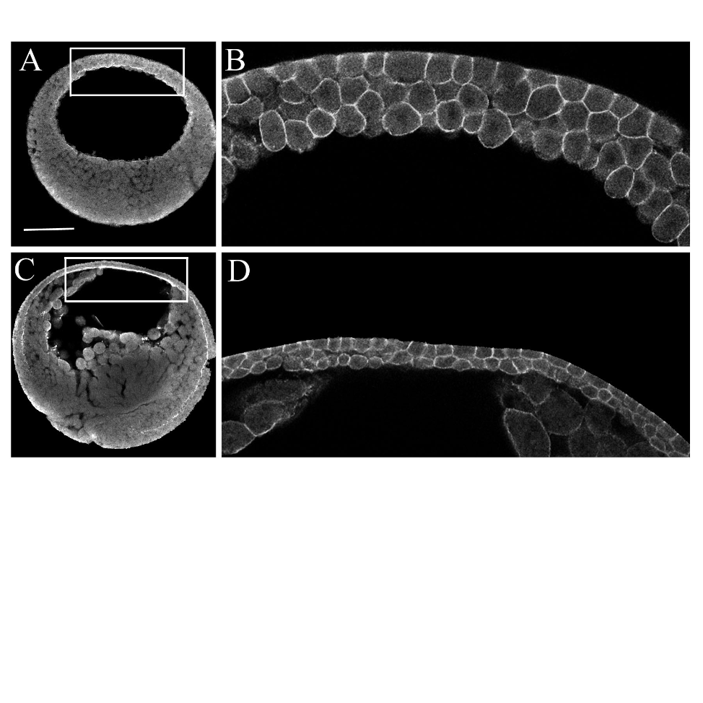
Suggest how organisms develop
in space
in time

Slide 3
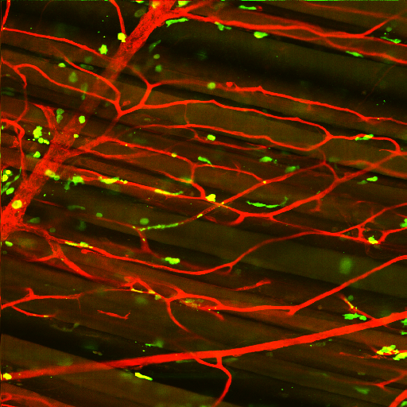
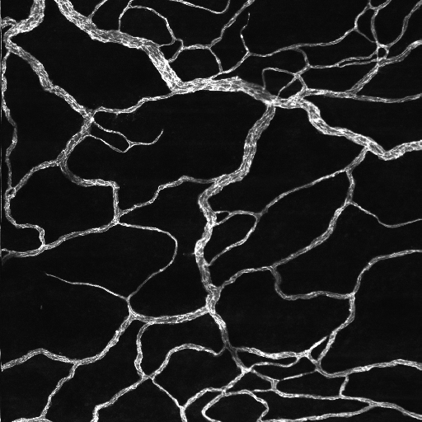
Indicate how tissues function physiologically
Muscle
Mesentery
Tree-like, hierarchical network
Looping, 'random' network

Slide 4
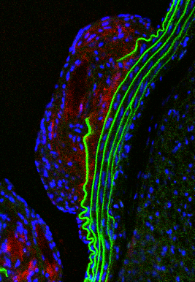
Suggest how tissues respond to disease
Healthy Blood Vessel
Atherosclerotic Plaque

Slide 5
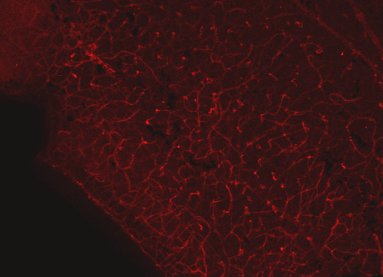
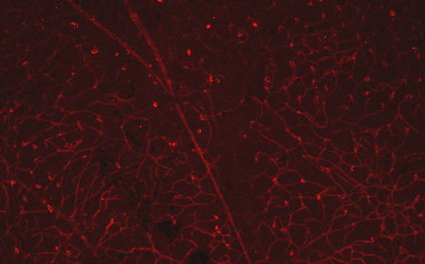
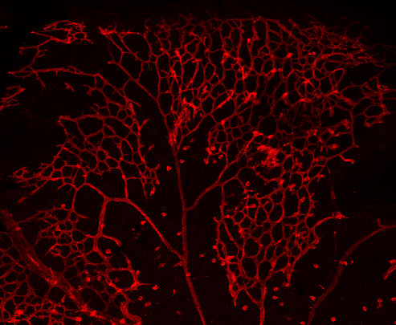
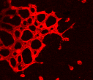
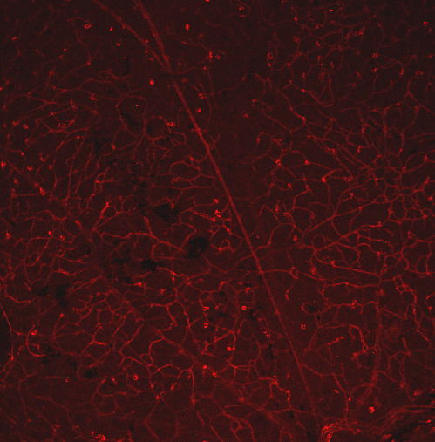
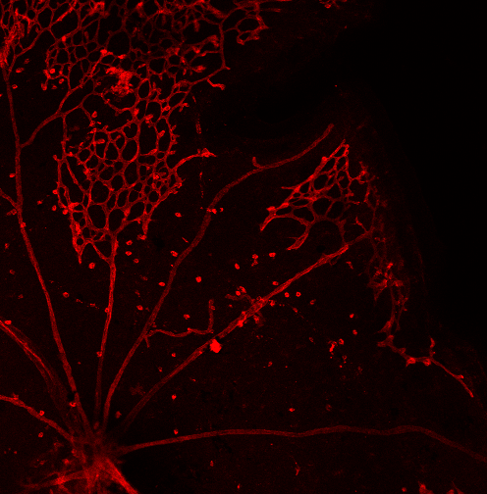
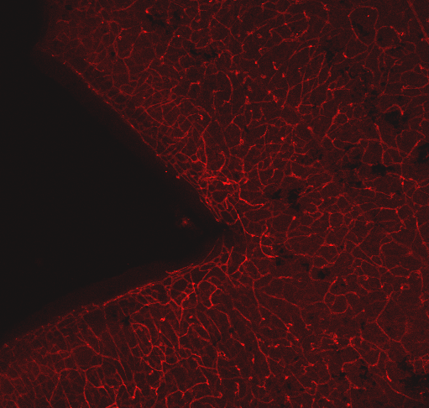
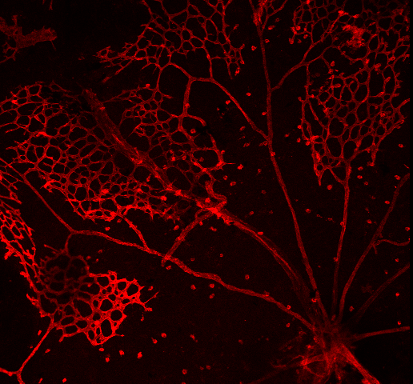
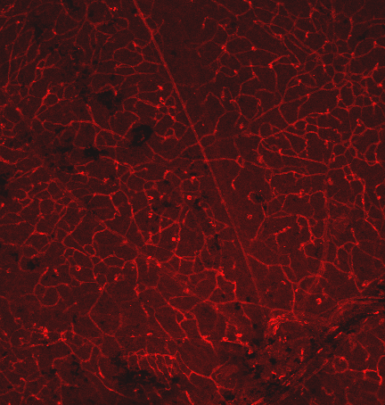
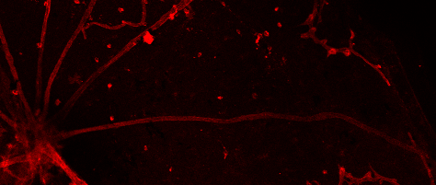
Diagnose healthy from diseased tissue
Normoxia
Hyperoxia
A
A
V
*
V
*
*
*
*
*
A
V
A
V
V
*
*
V
50 μm
Healthy Retina
Diseased Retina (ROP)

Slide 6
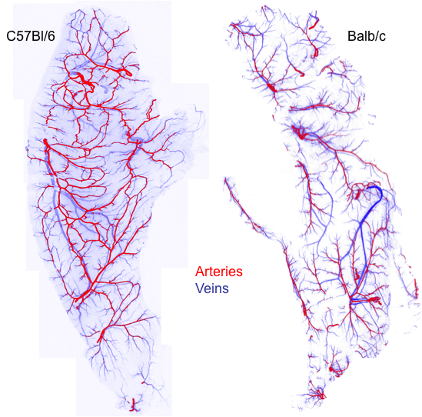
Tell us which patients need therapy (personalized medicine)
Protected from ischemia
Vulnerable to ischemia

Slide 7
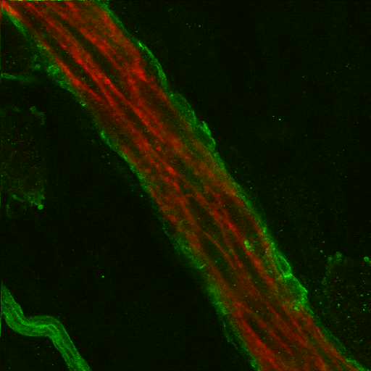
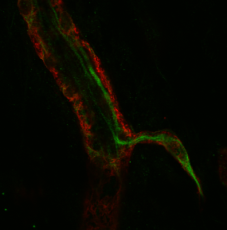
Tell us if a drug is working
Mature microvessel
New microvessel sprout

Slide 8
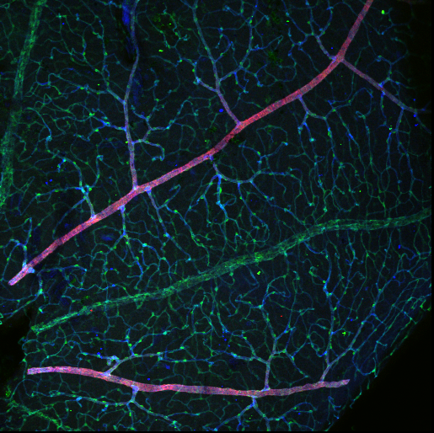
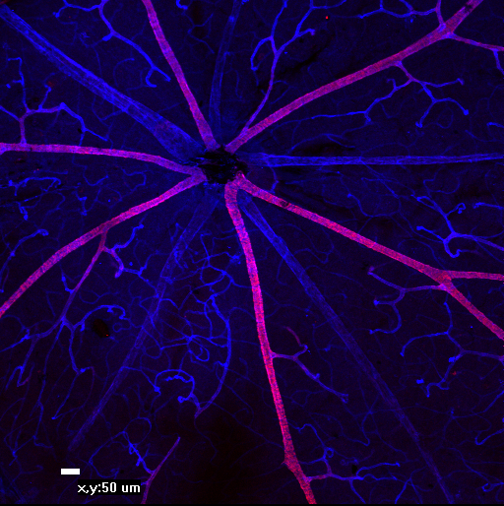
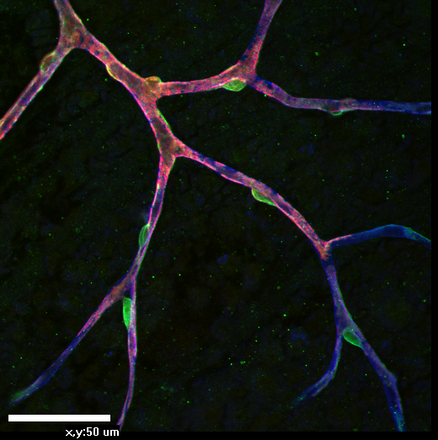
Challenges to Studying Tissue Patterning
Complex network of signals
Dynamic
Heterogeneous

Slide 9
Agent-Based Modeling of Cells
. Dynamic, complex system of many discrete agents (1 agent = 1 biological cell)
. Agents interact with each
other and with their
environment
. Agents make decisions in space & time according
to literature-based rules

Slide 10
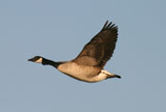
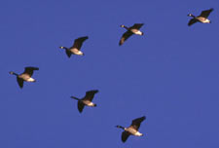
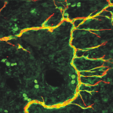
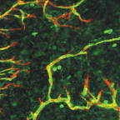
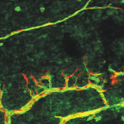
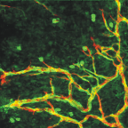
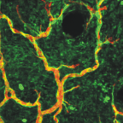
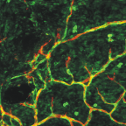
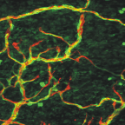
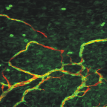
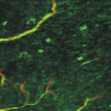
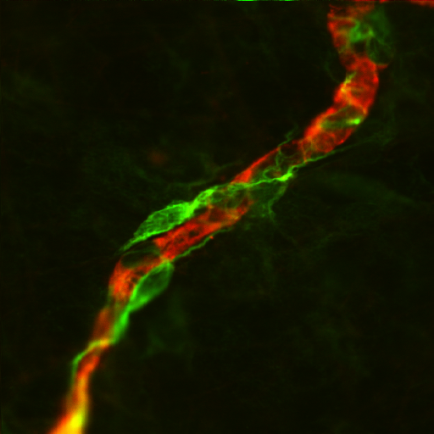
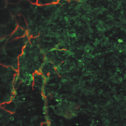
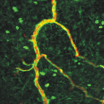
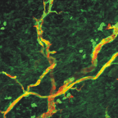
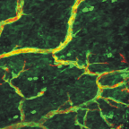
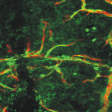
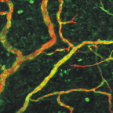
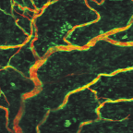
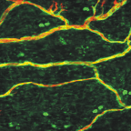
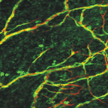
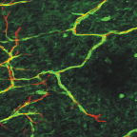
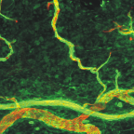
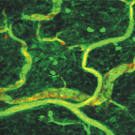
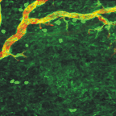
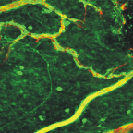
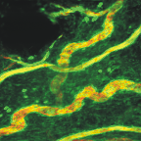
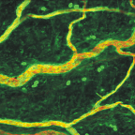
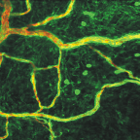
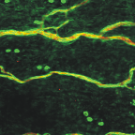

































Emergent Phenomena

Slide 11

Benefits of ABM
. Spatial & temporally dynamic instantiation of hypotheses (integrate the knowledge of the field)
. Access to cell lineage/history information
. Incorporate biological stochasticity
3
1
4
2

Slide 12

Parallel Approach
Experiments & Computational Models
Experimental Observations
Question
Experimental
Data
Hypothesis
Generation
Integrative Computational
Model
Hypothesis
Refinement
New Experiments
Validation
Conclusion
Informed Design

Slide 13

Ischemic Disease
Atherosclerotic Lesion in the Left Anterior Descending Coronary Artery
Ischemia
Collateral arteries
Rahman et al. 2000

Slide 14


Sham Control
Ischemic Ligation
How?
Therapeutically
augment?
Bailey et al., 2008
Mac Gabhann and Peirce, 2010

Slide 15


Use Stem Cells to Grow Collateral Vessels?
Inject stem cells i.v.
Stem cells traffic to sites of injury and extravasate
Stem cells incorporate into blood vessels and/or promote smooth muscle cell proliferation

Slide 16

Experimental Observation
Inefficient trafficking: 0.01-1% of all i.v.-injected progenitor cells end up in injured tissues.

Slide 17
Question / Design Goal
Is it possible to enhance progenitor cell homing?
Design Goal: Achieve more efficient cell homing by manipulating hASC adhesion signals.
Notes:
This is a crappy hypothesis. It's way too broad and needs to be focused down, but there are dozens of adhesion molecules and chemokines that impact this system in vivo...the system is so complex...where do we start?

Slide 18

Experimental Data (leukocyte adhesion cascade)
margination
rolling
firm
adhesion
BLOOD
FLOW
trans-
migration
extravasation
migration

Slide 19

Adhesion Data
hASCs adhere to endothelial adhesion molecules (in vitro)
hASC Adhesion Capabilities
% of cells adhered
110
100
*
90
80
*
70
*
*
60
50
40
30
20
10
0
Tween20
VCAM-1
Fibronectin
Collagen Type 1
ICAM-1
Amos*, Bailey*, Peirce, Ann. Plastic Surgery, 2008

Slide 20

Hypothesis Generation
hASCs home to injured endothelium in a manner similar to monocytes.

Slide 21
Model Structure:
Adhesion Molecules
Rolling on circulating cell
FLOW
Rolling on EC
Firmly adhere circulating cell
Firmly adhere EC
PSGL-1
CD34
ICAM-1
CD34
LFA-1
L-sel
VLA-4
MAC1
PSGL-1
VCAM-1
L-sel
MAC1
VLA-4
LFA-1
CD34
P-sel
VCAM-1
ICAM-1
E-sel
ENDOTHELIUM

Slide 22
Model Structure:
Chemokines
hASC
SDF-1α MCP-1 IL-1 IL-8
MCP-1 TNF-α IL-1
TGF-β NO IL-1β
TNF-α IL-1 IL-8
Endothelial Cell
TGF-β SDF-1α MCP-1 IL-1 IL-8
TGF-β
TGF-β TNF-α IL-1
MCP-1 TNF-α IL-1 IL-10 TGF-β
TGF-β
MΦ
TGF-β IL-10
Monocyte
TGF-β IL-10
IL-10 TGF-β
Notes:
Theoretical connections… don’t necessarily occur
TGF and IL-10 and NO are generally anti-inflammatory, others genearlly pro-inflammatory
Connection drawn if a cell secretes it
Connection drawn if has any of the follow effects: changes CAM, changes secretion, changes integrin activation
IL-6 is also present, but currently no connections so is not depicted here

Slide 23


Obtain Initial Networks from In Vivo Model
2.
1.
B
3.
Endothelial Cells
SMCs
Monocytes/macrophages
hACSs

Slide 24
Agent Rules
Step
Conduct Plasma Proteins
Survey Endothelium
EC Actions
Check adhesion proteins
on ECat current location
Survey Environment
(WSS, cytokines)
Check WSS at current location
11: cell behaviors
Determine likelihood
of adhesion molecule
expression
Determine rolling likelihood
(WSS & visible selectins)
Express adhesion
molecule?
Roll?
yes or no?
yes or no?
85: adhesion molecule expression
Determine likelihood
of cytokine secretion
Determine adhesion likelihood
(WSS, cytokines, & visible integrins)
Secrete cytokine?
Adhere?
yes or no?
yes or no?
Monocyte Actions
Return to
previous chart
69: chemokine production & activation
Adhered?
y
WSS Low
Enough to remain?
y
Migrate or
Return to Flow?
y
Migrate
n
n
n
Detach & Move
Rolling?
y
Call “Survey
Endothelium”
Adhered?
y
Wait until next
timestep
n
n
Rolling?
y
Move,
Continue Rolling
30: integrin activation
n
Time to Survey?
y
Call “Survey
Endothelium”
Detach & Move
n
y
Adhered?
Wait until next
timestep
~200 total rules
n
Rolling?
y
Wait until next
timestep
n
Move

Slide 25


ABM Output: Circulating Cell
Adhesion and Extravasation
A
A
V
V
C
C
Bailey*, Thorne*, Peirce, Ann. Biomedical Eng, 2007

Slide 26
In Silico 'Knockout' experiments to understand relative contributions
30
*
*
25
Rolling on EC
20
Firm Adhesion
ABM Predicted
Number of Extravasated Monocytes
15
L-sel
PSGL-1
MAC1
VLA-4
LFA-1
10
P-sel
CD34
VCAM-1
ICAM-1
E-sel
selectins
integrins
5
0
Control
L-Selectin
Knockout
E- & P-Selectin
Knockout
PSGL-1
Knockout
VCAM-1
Knockout
ICAM-1
Knockout
Bailey*, Thorne*, Peirce, Ann. Biomedical Eng, 2007
ABM Insight #1:
If hASCs are like monocytes then
adhesion to integrins is important in homing

Slide 27
Hypothesis Refinement
Monocytes
hASCs
60
Rolling on EC
Firm Adhesion
50
40
SBM-X
L-sel
ABM Predicted
% of Extravasated Cells
PSGL-1
VLA-4
MAC1
LFA-1
30
P-sel
CD34
VCAM-1
ICAM-1
*
E-sel
20
selectins
integrins
10
32% rolled
32% rolled
17% rolled
1% rolled
0
Allow
adhesion
to p-sel
No adhesion
to p-sel
Allow adhesion to p-sel
No adhesion
to p-sel
ABM Insight #2:
Unlike monocytes, hASCs may rely on selectins for extravasation

Slide 28
In vitro validation:
hASC Interactions with P-selectin
Instantaneous Velocity of hASCs in Parallel Plate Flow Chamber with P-Selectin Substrate
600
Average Velocities of Strong Interactors with P-selectin
Interactor
500
400
100
Speed (microns/sec)
90
300
200
80
100
70
0
60
Rolling on P-selectin
0
0.2
0.4
0.6
0.8
1
1.2
1.4
Avg. Speed (mm/sec)
Time (seconds)
50
600
Strong Interactor
40
500
30
400
20
300
10
Speed (microns/sec)
200
0
0.5
100
0
WSS (dynes/cm²)
0
0
0.5
1
1.5
2
2.5
3
Time (seconds)
Bailey et al. PLoS Comp. Biol., 2009

Slide 29
Testing possible therapeutic outcomes: cell-cell interactions
60
50
Adherant to hASC
40
% of Extravasated Cells
Rolling on hASC
30
20
10
0
Monocytes
without
hASCs
Monocytes
with hASCs
ABM Insight #3:
The presence of hASCs may increase monocyte extravasation

Slide 30
Designing therapeutic strategies
10
9
8
7
6
Extravasated hASCs (%)
5
*
4
3
**
2
1
0
Control
MCP-1 KO
IL-8 KO
IL-1β KO
SDF-1α KO
ABM Insight #4:
SDF-1α may be a good target for manipulation

Slide 31



ABM Insight #4:
SDF-1α may be a good target for manipulation
Control
# hASCs in ischemic / # hASCs in contralateral
SDF-1α treated
- SDF-1
Block CD49d
+ SDF-1

Slide 32
How is Combining ABM with Experiments Useful?
Identify key parameters
Quantitatively pinpoint voids in understanding
Compare alternative hypotheses
Suggest and refine new hypotheses
(e.g. VCAM-1)
(e.g. P-sel)
(e.g. SDF-1α)
(e.g. secondary capture)
Accelerate discovery process
Peirce, Skalak, Papin, IBM Journal of Research, 2006
Thorne, Bailey, Peirce, Briefings in Bioinformatics, 2008
Thorne, Bailey, DeSimone, Peirce, Birth Defects Research, 2008

Slide 33






Acknowledgements
Peirce Lab
Alex Bailey, Ph.D.
Bryan Thorne
Peter Amos
Alyssa Taylor
Jason Glaw
J’Neka Claxton
Blair Stocks
Carolyn Mulvey
Katelyn Murray
Yi Cai
UVA Biomedical Engineering
Jason Papin, Ph.D.
Mike Lawrence, Ph.D
Ed Botchwey, Ph.D.
JHU Institute for Computational Medicine
Feilim Mac Gabhann, Ph.D.
Texas A&M Biomedical Engineering
Jay Humphrey, Ph.D.
UVA Dept. of Plastic Surgery
Adam J. Katz, M.D.
La Jolla Institute for Allergy & Immunology
Klaus Ley, M.D.
UVA Dept. of Cell Biology
Doug DeSimone, Ph.D.
ROBERT M. BERNE
CARDIOVASCULAR RESEARCH CENTER

Slide 36

In vivo validation: hASC homing

Slide 37

In vivo validation: hASC homing
preferentially to ischemic muscle
24 hours after injection
96 hours after injection

Slide 38

...and what do hASCs do
when they arrive?
Native pericyte
hASC
hASCs behave like pericytes (precursor cells?)
Amos et al. Stem Cells, 2008

Slide 39


...and what do hASCs do
when they arrive?
Native retinal pericyte
hASCs
hASCs behave like pericytes (precursor cells?)

Slide 40

Mechanism of Recruitment (?)
ABM assumes random walk & adhesion to vessels
Percentage of total hASCs in contact with vessels
80
*
70
60
50
% of hASCs
40
30
20
10
0
In Vivo
ABM
Prediction

Slide 41
ABM Insight #5:
hASCs use PDGF-BB/PDGF-βR to home to endothelium
90% of hASCs express PDGF-βR
In Vitro Migration
20
*
15
% of migrated hASCs
10
5
0
PDGF-BB
+
+
PDGF-βR Ab.
-
+

Slide 42




























What do we (think we) know about this process?
Healthy muscle vasculature has compensatory response: arteriogenesis
C57BL/6
C57BL/6
Non-ligated
contralateral control
A
Ischemic insult
(arterial ligation)
Bailey, O'Neill, Morris, Peirce, Microcirculation, 2008

Slide 43
Capillary Arterialization in Response to Ischemia
Sham Control
Ligated
Ligated

Slide 44

Capillary Arterialization in Response to Ischemia
Sham Control
Ligated

Slide 45
Angiogenesis?

Slide 46
What do we (think we) know?
Monocytes are important in arteriogenesis
Wildtype mouse
CD11b (+)
cells accumulate
CD-44-deficient mouse
CD11b (+) cells
SMA (+) vessels
van Royen et al., Circulation, 2004
Bailey*, Thorne*, Peirce, Ann. Biomedical Eng, 2007

Slide 47
What do we (think we) know?
hASCs adhere to endothelial adhesion molecules (in vitro)
hASC Adhesion Capabilities
% of cells adhered
110
100
*
90
80
*
70
*
*
60
50
40
30
20
10
0
Tween20
VCAM-1
Fibronectin
Collagen Type 1
ICAM-1
Amos*, Bailey*, Peirce, Ann. Plastic Surgery, 2008

Slide 48

Network Flow Model
BLOOD FLOW
Bailey*, Thorne*, Peirce, Ann. Biomedical Eng, 2007

Slide 49

ABM Cell Lineage Tracking
ABM Prediction
Location of Extravasation
A
V
Arteriole bed
Venule bed
C
Capillary bed
Bailey*, Thorne*, Peirce, Ann. Biomedical Eng, 2007

Slide 50
Combining ABM with Models at other Scales?
Intracellular Network
Multi-cellular
Peirce et al., IBM Journal of Research, 2006

Slide 51



Mesendoderm Migration
Xenopus explant, 60x, cad7 staining
Lee et al., PLoS Comp. Bio. 2003.
Robertson et al., BMC Systems Biology, 2007

Slide 52
Combining ABM with Models at other Scales?
Intracellular Network
Multi-cellular
Tissue-level

Slide 53






Intracellular
Signaling
Multi-cell
Interactions
Tissue-level
Mechanics
PDGF
PDGFR
RAS
GAP
GRB2
SOS-1
GDP
GTP
RAS
JAK1
SHC
STAT1
STAT3
RAF1
MEKK1
STAT1
STAT3
MEK1
JNKK1
STAT3
STAT3
ERK
JNK1
STAT1
ERK
JNK1
STAT3
STAT3
ELK1
c-JUN
STAT3
MMP-9 Production
Growth
1.0
1.0
1.0
PDGF-BB
Thickness
0.8
RAS
0.8
0.8
Hoop stress
0.6
0.6
Microvascular
Density
Normalized Value
Macrophages
0.6
Normalized Value
Normalized Value
0.4
0.4
Foam Cells
0.4
0.2
PDGF-βR
ELK1
0.2
MMP-1
0.2
PDGF
0
0
0
1 2 3 4 5
1 2 3 4 5
10 20 30 40 50 60 70 80 90 100
Time (Hours)
Time (Days)
Time (Days)
Notes:
Drug target discovery – which molecules to focus on
Dosing regimens / potency assays – how much to deliver and when to deliver the drug
Test combination therapies – multi-pronged attack
Determine mechanism of action – why does it work?
Identify unwanted side effects, compensatory pathways – why might it fail?

